Slide 1
Individual study 2019fall at CGI lab
0712238 林彥彤

Slide 2
Works related this semester
Implement a no go program based on MCTS with RAVE(EazyNoGo)
Take Deep Learning course and learn about building and validating models
Write a efficient block go game board program

Slide 3
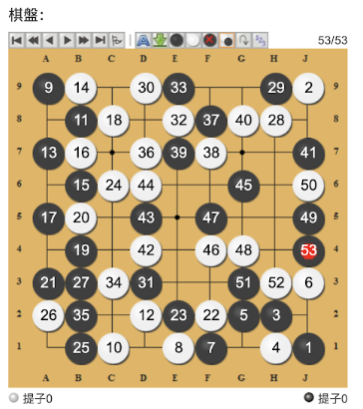
EazyNoGo
MCTS
RAVE
Adjustments for nogo

Slide 4
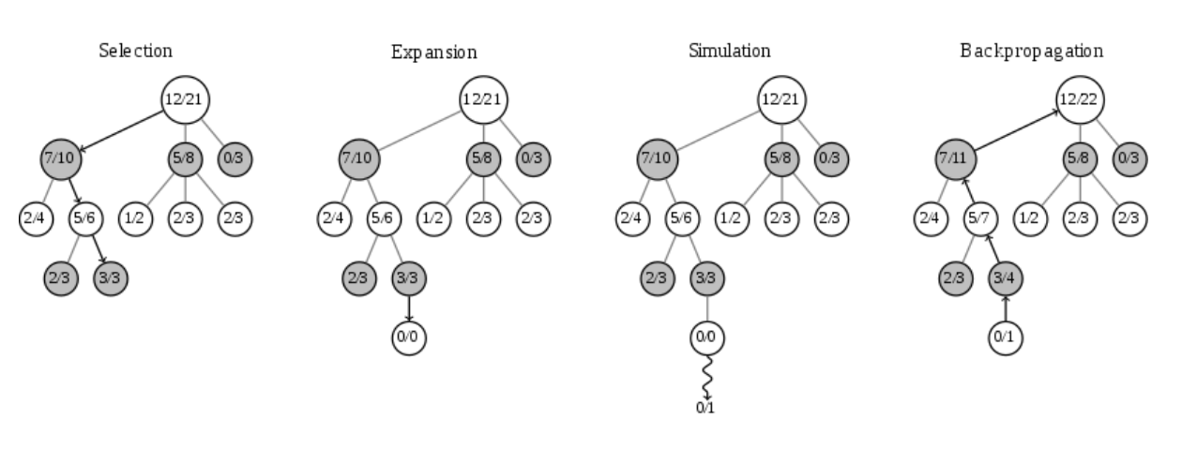
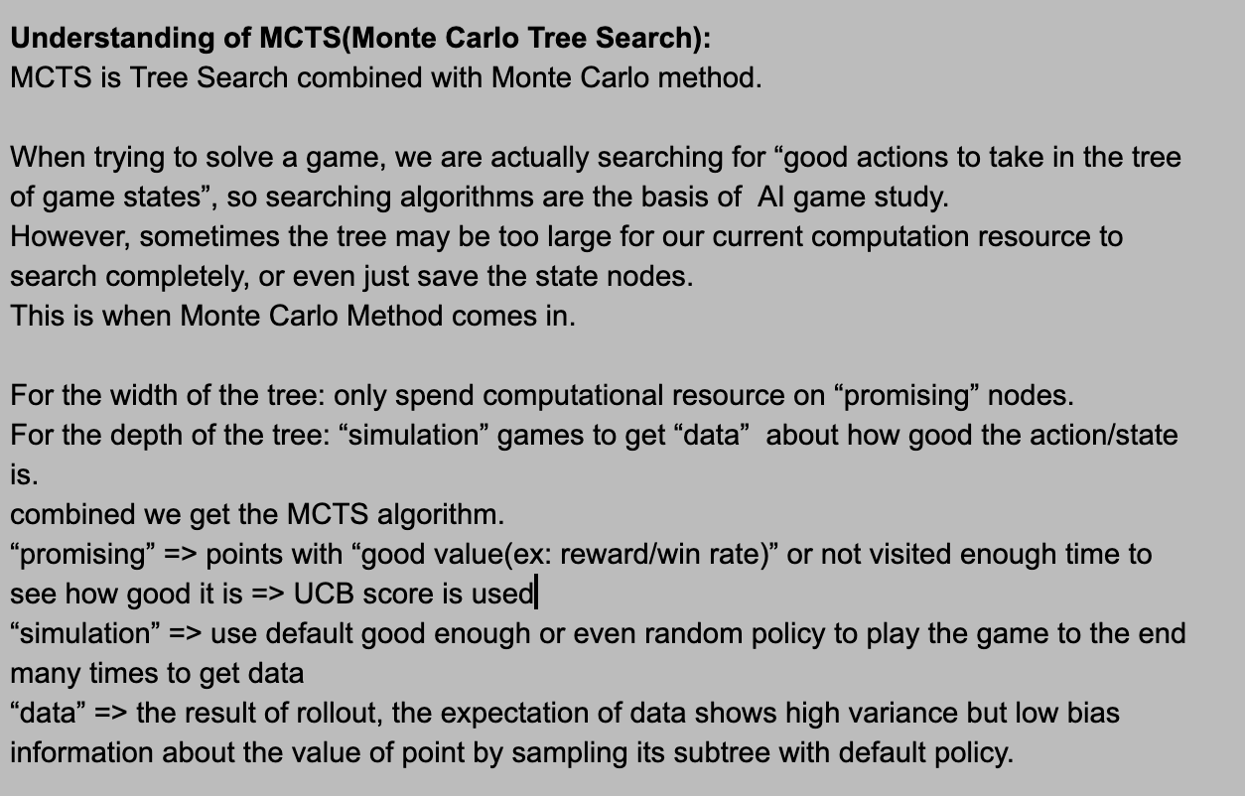
MCTS - Monte Carlo Tree Search

Slide 5
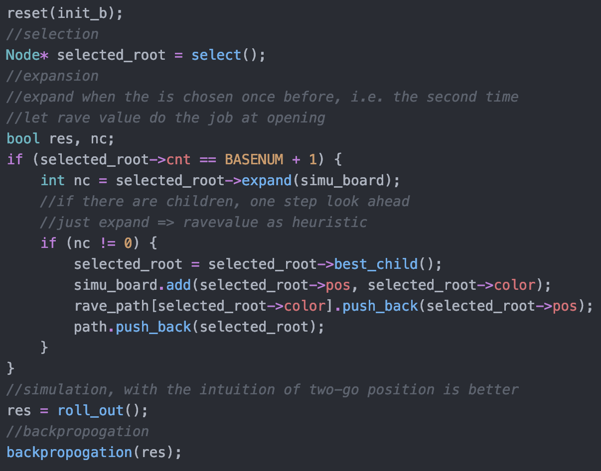
MCTS structure

Slide 6
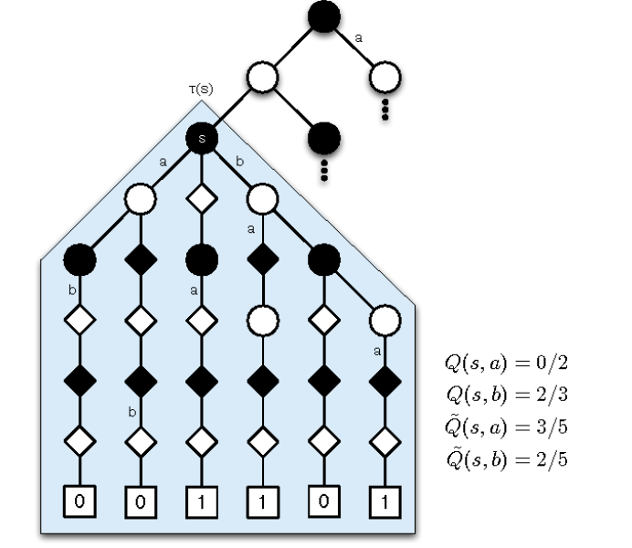
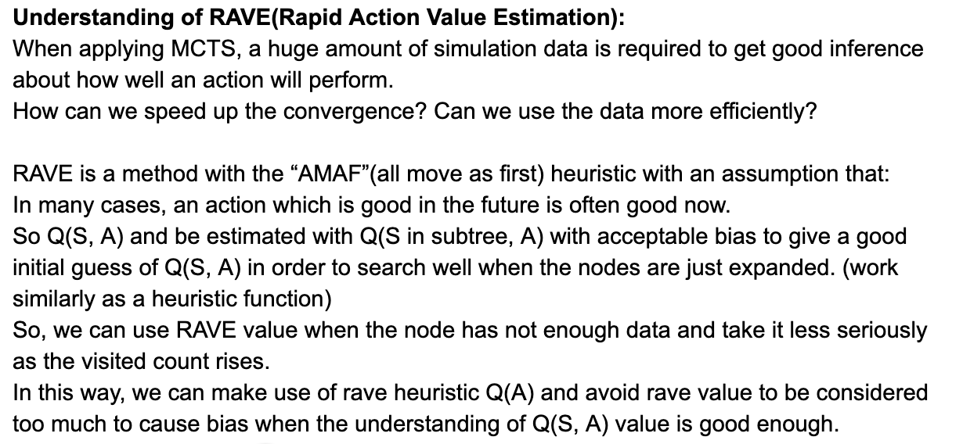
RAVE - Rapid Action Value Estimation

Slide 7
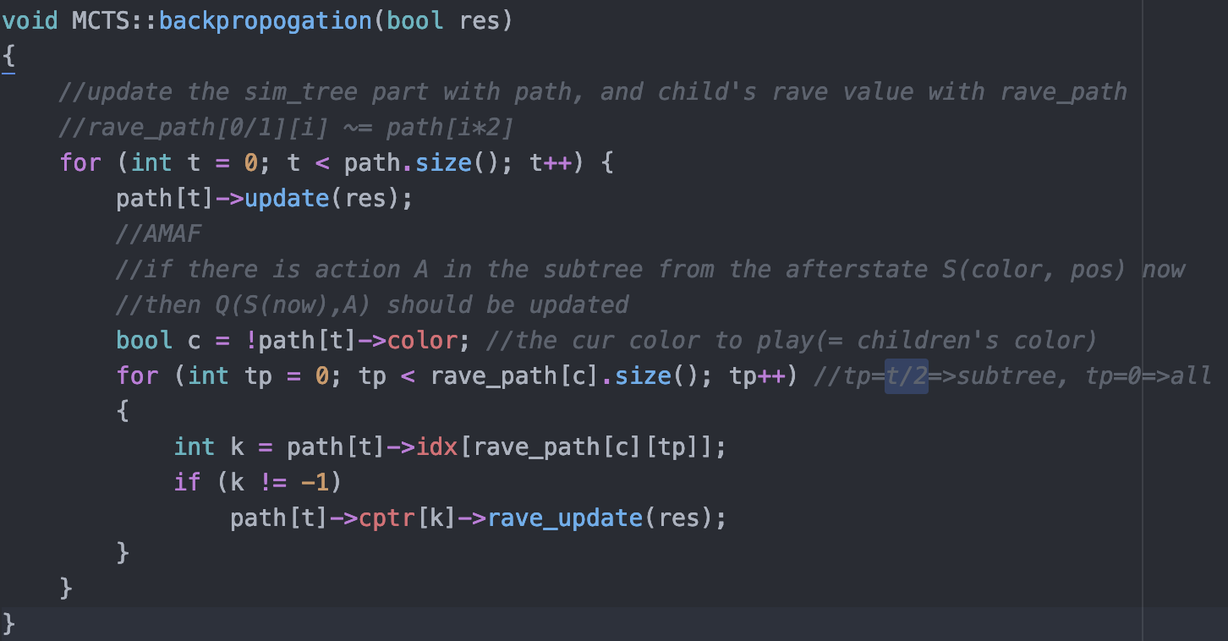
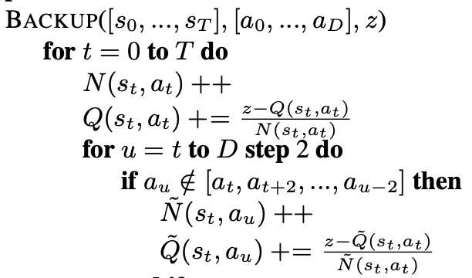
Rave Update

Slide 8
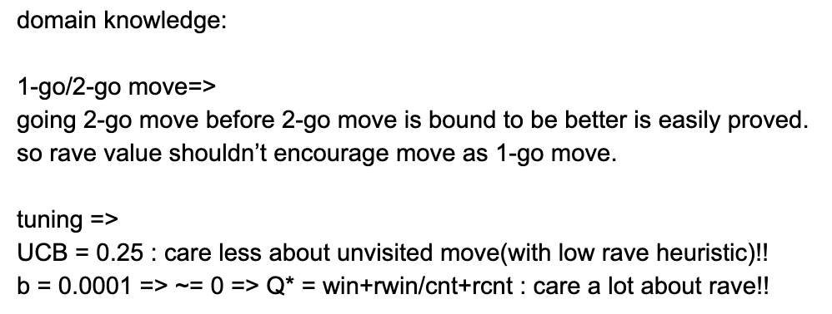
Adjustment for nogo task
rollout policy and hyper param

Slide 9
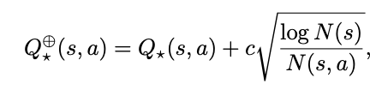
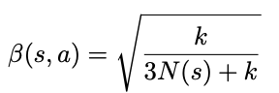
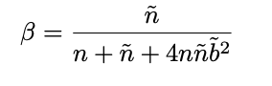
Q value used in eazynogo
Q~ is RAVE(AMAF) value
First use the upper one, then use the lower one
Lower one performs better (experimented)
Rave value is dominant in this scenario

Slide 10
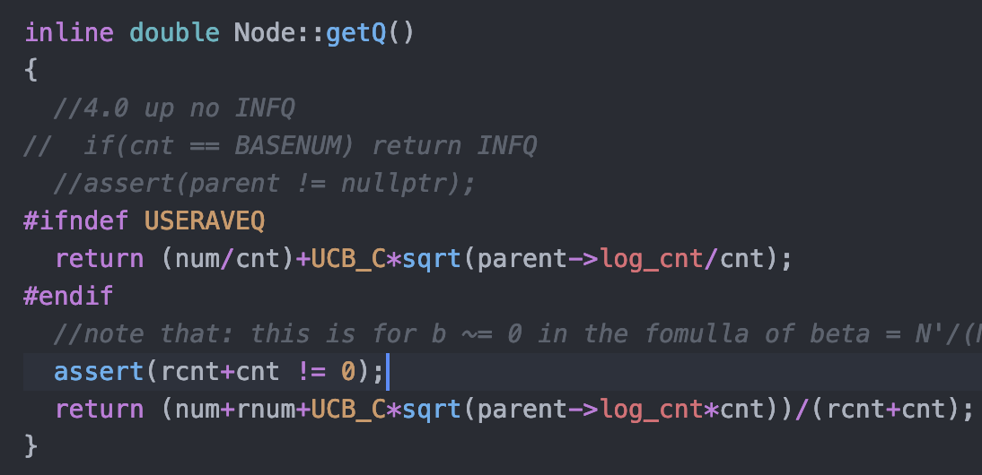
Q score function

Slide 11
Experiments
There were some unrecorded intermediate experiments
Versions of eznogo(1.0(no rave)-x.x-7.0(final))
When a change is make, would compare it to the last version and hahanogo with same simulation count, and check the moves to see if bad move happens
Should do more systematically and record the processor
May want to use python script to do it
Parallelization may be required in zero

Slide 12
Experiments
Different Q value formula => win+ravewin/cnt+ravecnt
Try some Cuct => 0.25
INFQ vs no INFQ (infinite Q value assign to BASENUM node, i.e. explore at least once)
Rave update by all path nodes or only subtree nodes
Expand on visit or on second visit
etc.
Overall “RAVE value heavy” and “less Exploration” is better

Slide 13
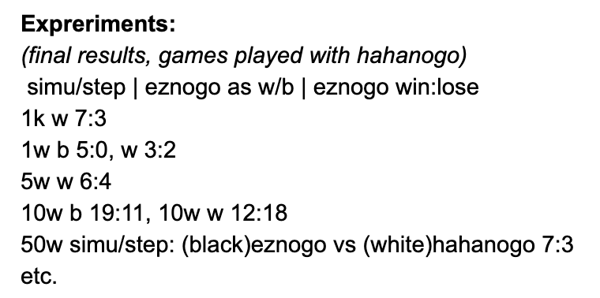
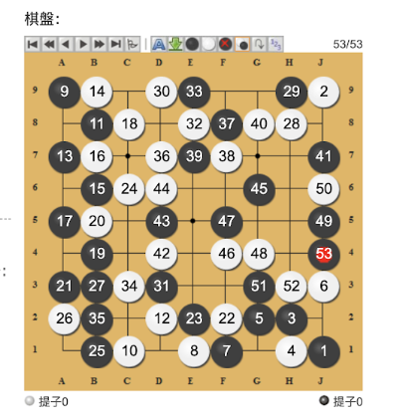
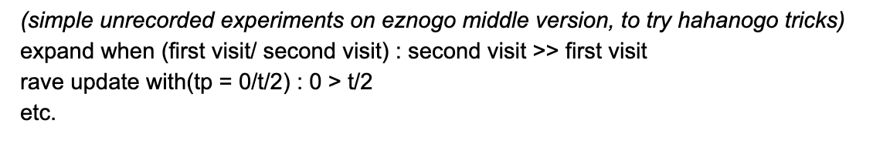
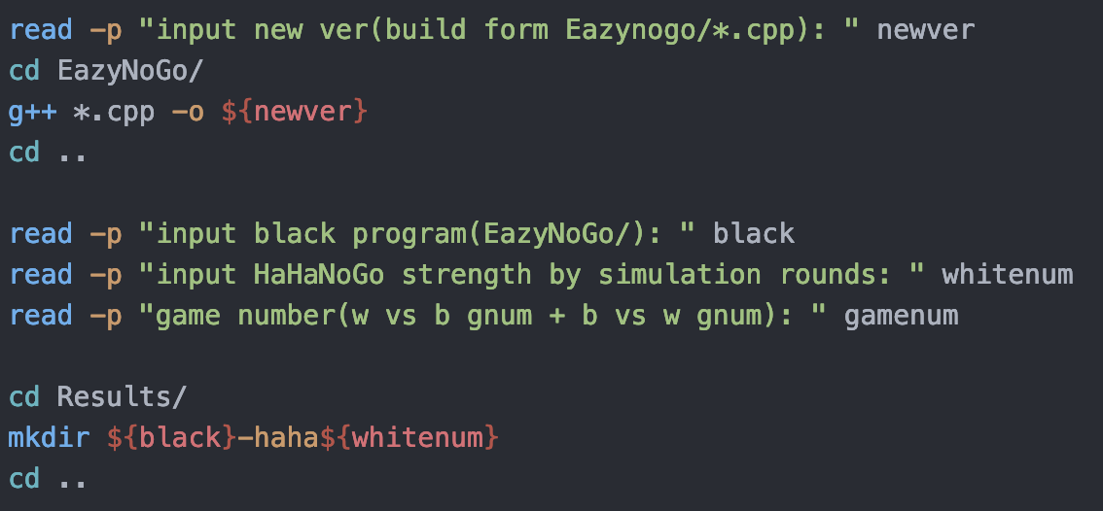
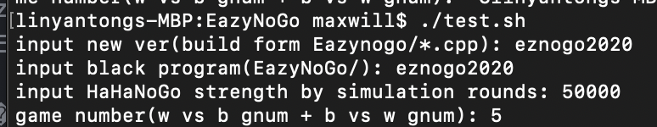
Experiments

Slide 14
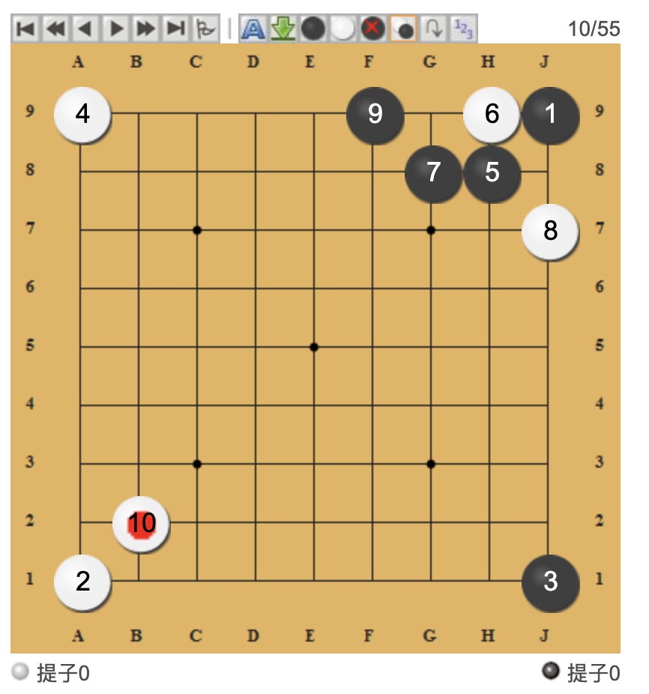
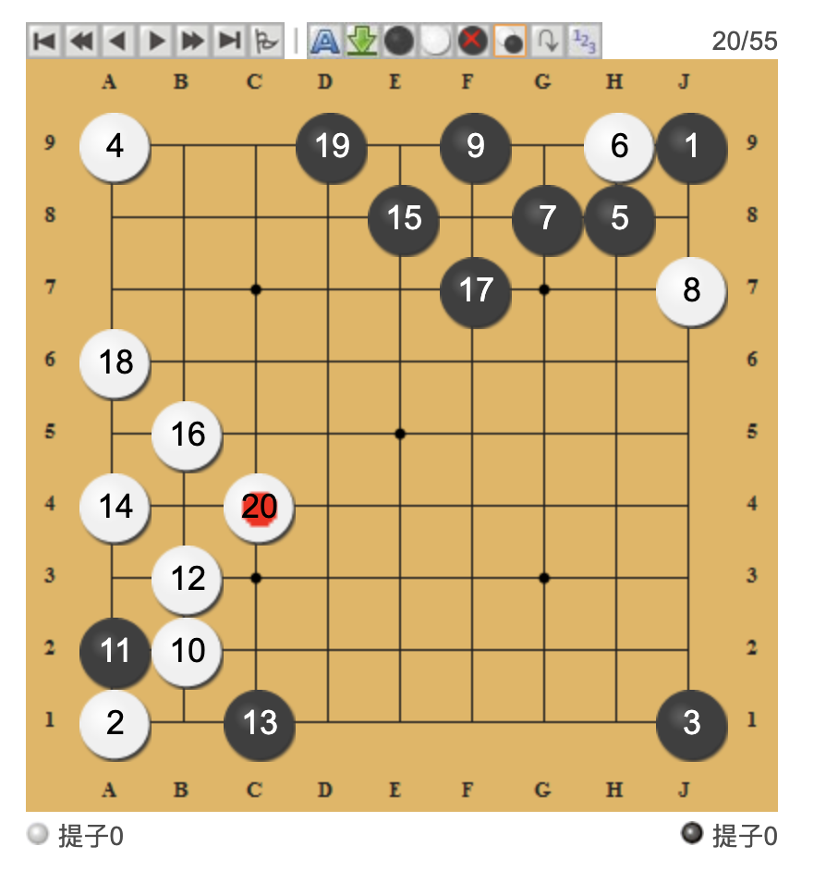
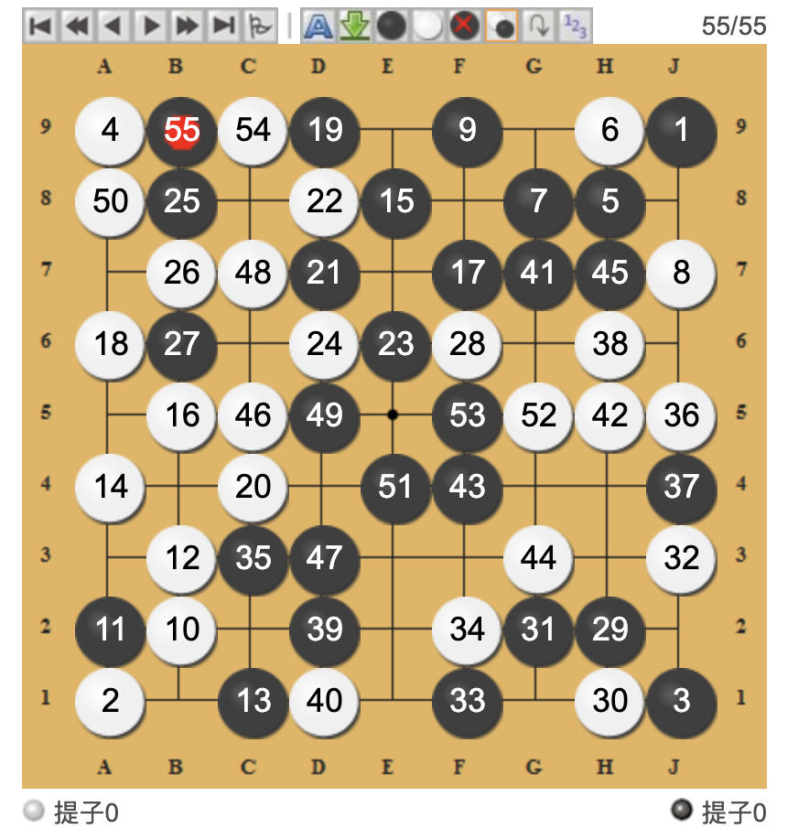
Joseki(eznogo vs hahanogo at 50k simulation)
Result : B+R at 57th move

Slide 15
References
mcts-rave algorithm : http://www.cs.utexas.edu/~pstone/Courses/394Rspring13/resources/mcrave.pdf
gogui download : http://gogui.sourceforge.net/
gtp2 documentations : https://www.lysator.liu.se/~gunnar/gtp/gtp2-spec-draft2.pdf
hahanogo

Slide 16
Deep learning
A feed forward network “from scratch”
CNN models
RNN models
Duckie Bot(with supervised learning)
Get familiar with deep learning model design and validating process for implementing model for alpha zero

Slide 17
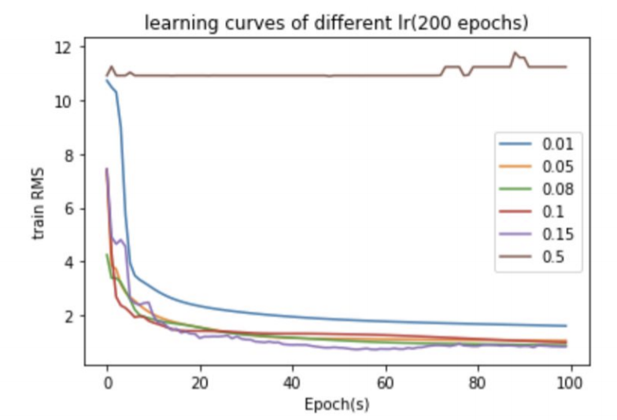
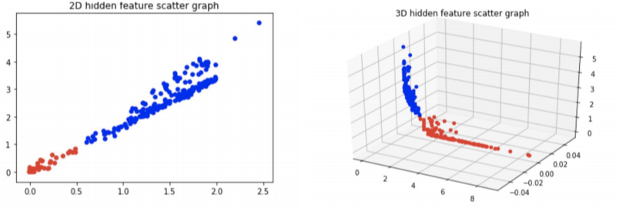

Slide 18
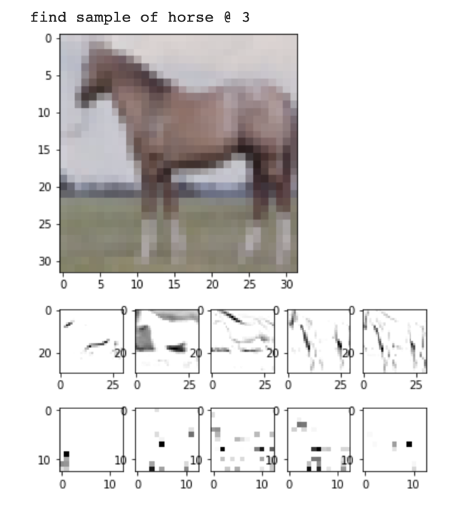
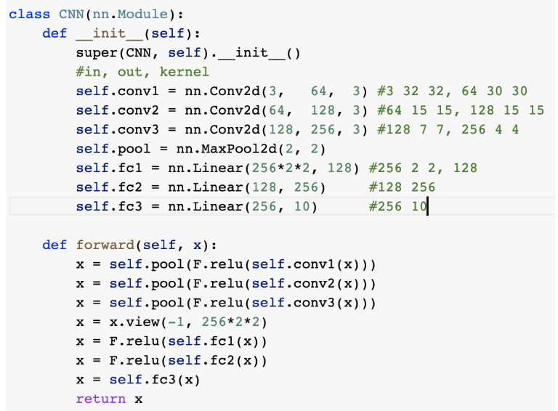

Slide 19
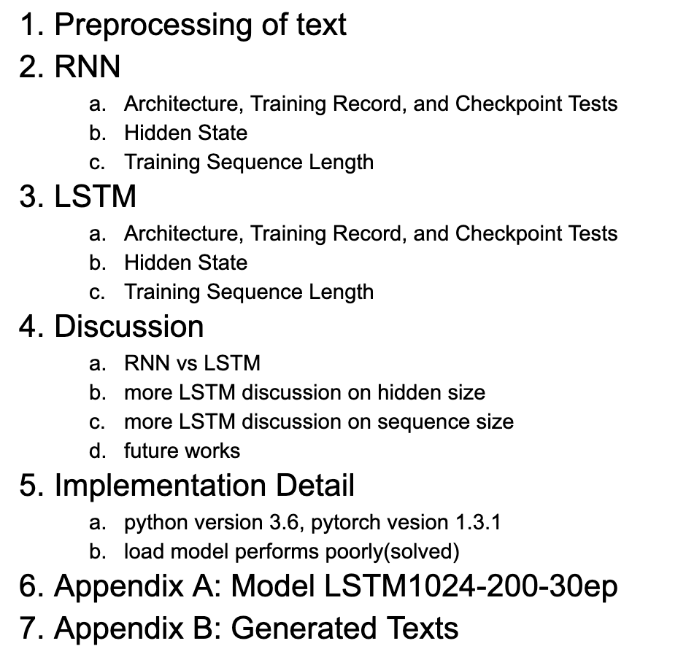
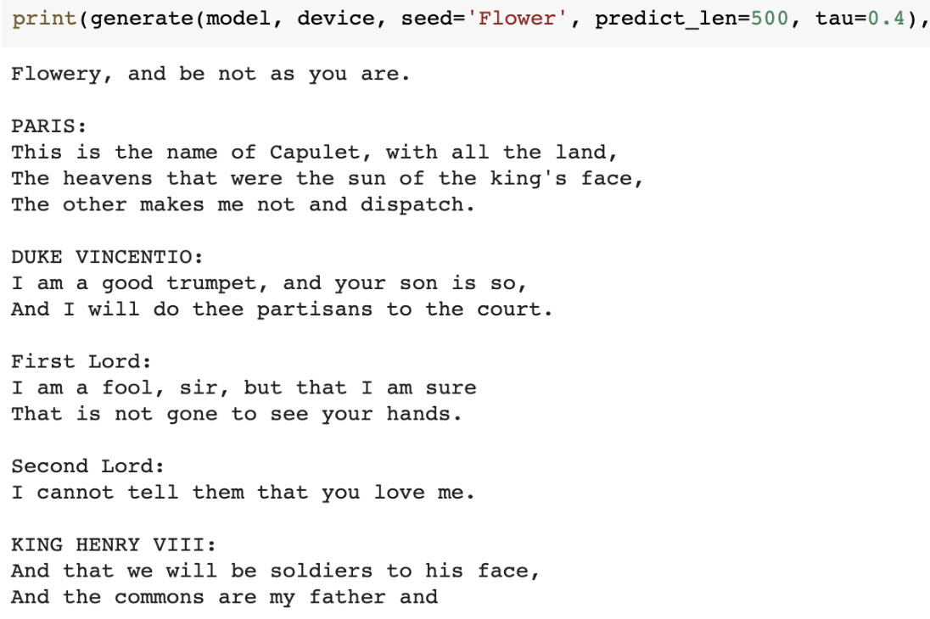
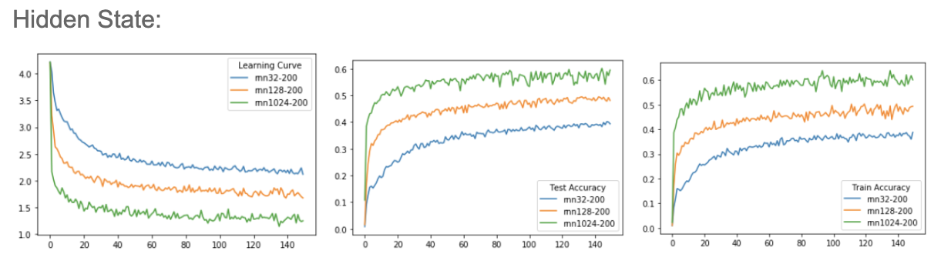

Slide 20
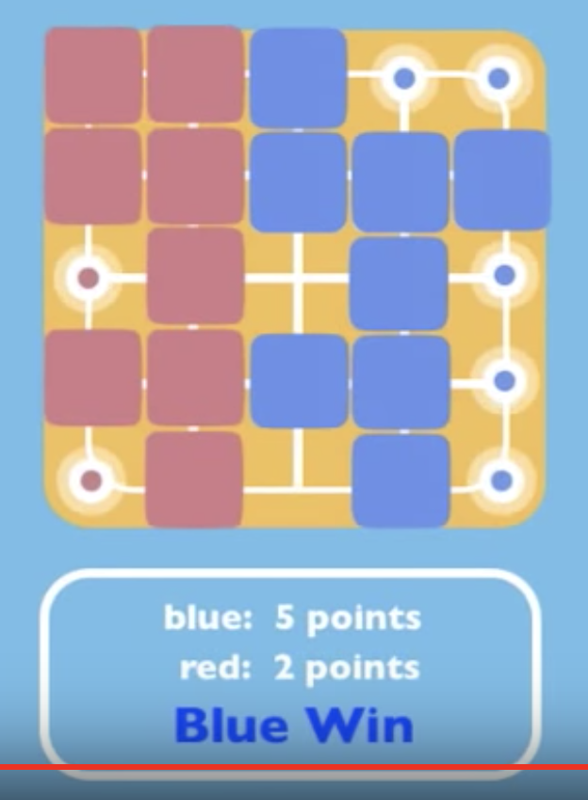
Block Go Board
Model the “blocks”
Check all action validity efficiently（valid contact points*4*20）
Calculate the territory efficiently(4*169+2*169)
A random simulation can be done almost on click
The code length is quite long… (6 files in total: var.h, board.h, …) (~450 lines in board.cpp alone)

Slide 21
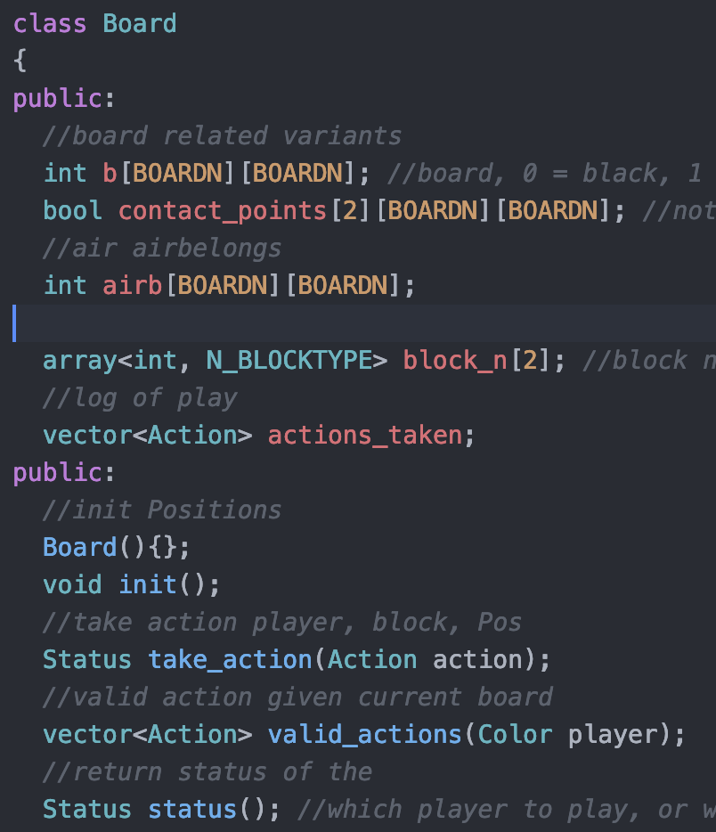
Board Class

Slide 22
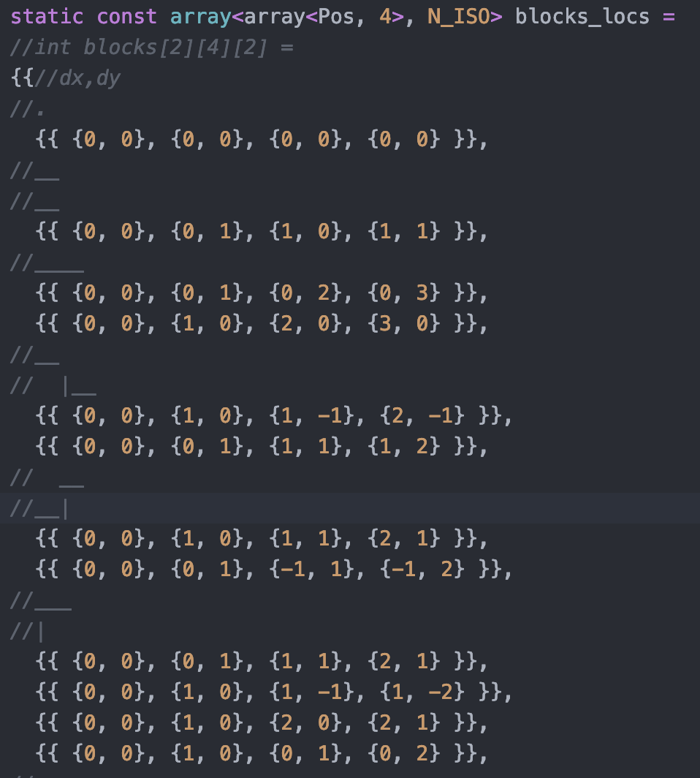
Block Representation(can be included by var.h)
Relative position to origin, when change origin

Slide 23
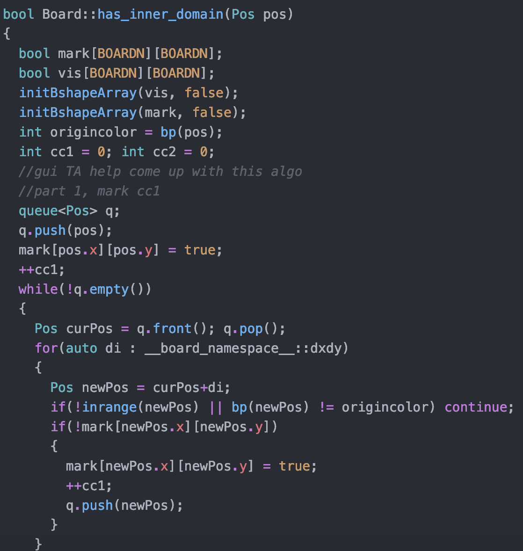
Calculate territory
First remove dead stones(judged by 2 bfs, one start from stone from that connected component(cc), one not from stone of the cc, if the two part = whole board => dead cc)
Second push all alive stone to bfs queue(of 2 color), for each color do bfs to fill the connected air that the air belongs to the color. If an area is only marked by one color, then the area belongs to the color, else is open area.

Slide 24

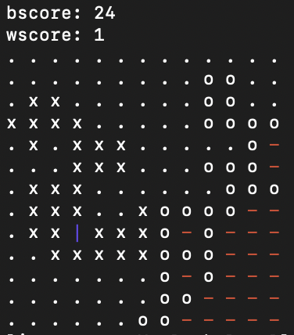
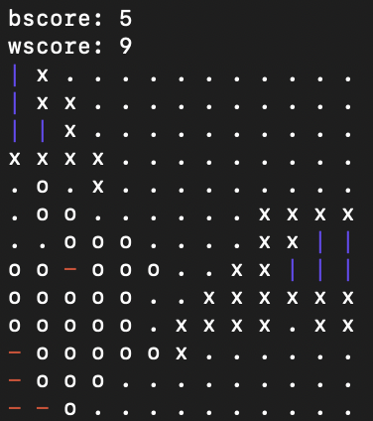
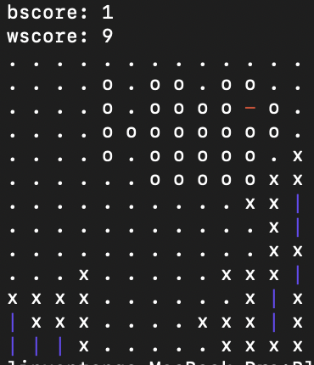
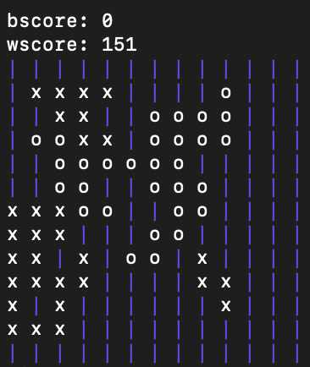
Some Random Games

Slide 25
Lessons from this semester
Implement an MCTS program
pytorch/tensorflow1.0/tensorflow2.0
Advance C++ programming(namespace, lambda, use of macros, terminal coloring, etc.)
Shell scripts(for experiment on programs quickly)
Get more experience in programming(DL, competitive programming, implementation of the projects, etc.)

Slide 26
Todo
Revise MCTS to use PUCT score and be more efficient
Implement and train an Alpha Zero agent for block go
Should use Elo and do records more systematically in future works
Survey papers in the field
May want to team up with other students in coding part

